Slide 1


Welcome!
Third Grade
Mrs. Ross
Room 39
Ross.hannah@cusd80.com

Slide 2
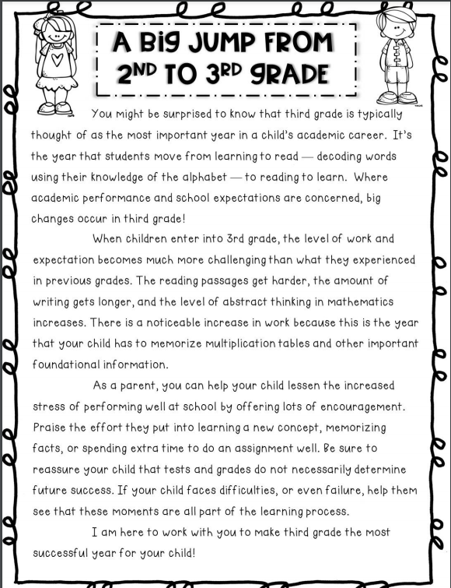

Slide 3
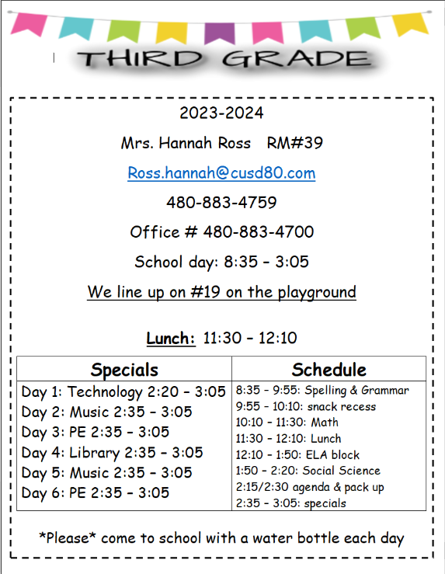

Slide 4
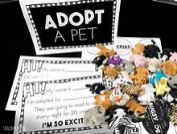
Classroom Information
Birthdays:
Birthdays are celebrated during our snack recess. You are welcome to send in store bought treats on your child’s special day. Please send in a simple treat such as cookies, donuts or cupcakes. Please nothing that requires cutting/scooping, bowls/plates, or utensils. Additionally, please make sure there is a label attached as we do have nut allergies in the classroom. If your child has an allergy, you are welcome to leave special treats with me in the classroom for these occasions.
Desk Pets:
Very soon students will be adopting a Desk Pet! Desk pets are miniature erasers shaped like animals. Teachers are using Desk Pets to motivate students and foster positive classroom behavior. With tickets earned from the Storm Report and other classroom activities, students will have the opportunity to visit "Paw-Mart" to purchase desk pet friends and accessories. If a student is having difficulty paying attention, following classroom expectations, or is caught playing with their pet instead of working, their pet must go to Pet Daycare for the day.

Slide 5
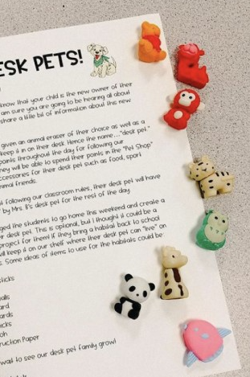
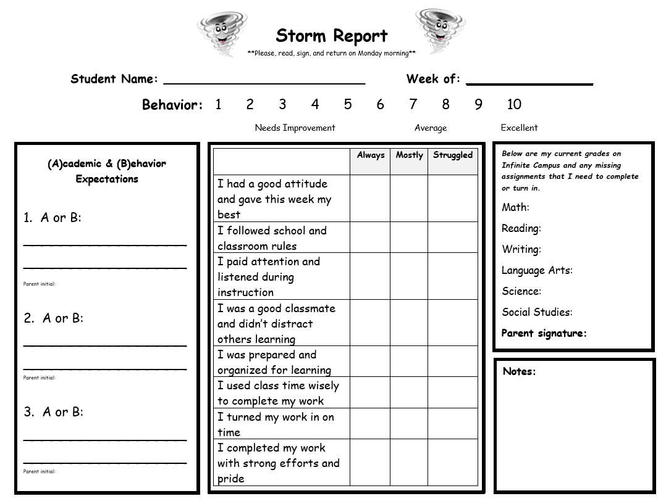
Classroom Information
Classroom Management
If a child chooses not to follow the STORM rules, they will fill out their storm report reflecting what occurred. If the issue continues, they have an appropriate consequence.
These are the steps that the students follow in the classroom:
1.Receive verbal reminder/warning. Assistance provided & restate directions of what is expected.
2. Write on weekly storm report indicating area of concern. Focus on possible solutions.
3. Student may fill out an incident awareness slip to be turned into the Dean.
4. Student goes to the Dean’s office and may serve detention. Parent will be notified if detention is scheduled.
Storm Report
Each Friday, students will be filling out a “Storm Report”. This Storm Report is in their binder and after filling out the behavior section, the students will bring it home to be signed. Storm Reports should returned with a parent signature every Monday. In addition, the students have a behavior chart on their Storm Report. If students are misbehaving, forgetting their homework or having any other issues that would require issuing a consequence, students will be required to fill out a letter. Additionally, please check and filling in grades over the weekend. If grades are written in and there is a parent signature, students will earn tickets for rewards & DESK PETS!!!

Slide 6
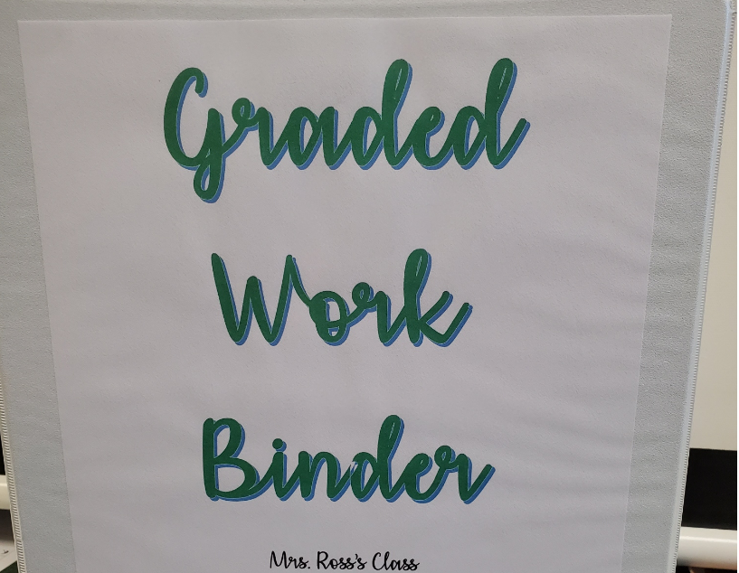
Graded Work Binder
Students will be utilizing a binder to track all of their graded work that is returned to them. This will be useful for students to help keep their graded work organized.
Graded work will be passed out to the students on Friday.
Graded work binders will then be sent home most Fridays. Parents will go through the graded work with their child to keep updated on your child’s progress.
All graded work will remain in the graded work binder each quarter and the binder will be returned to school every Monday.
Keep in mind, not all graded work will be placed in the graded work binder as some will be displayed on the walls, some will be informal observations or assessments, and some will be within journals or other forms of assessments that cannot be placed in a binder.

Slide 7

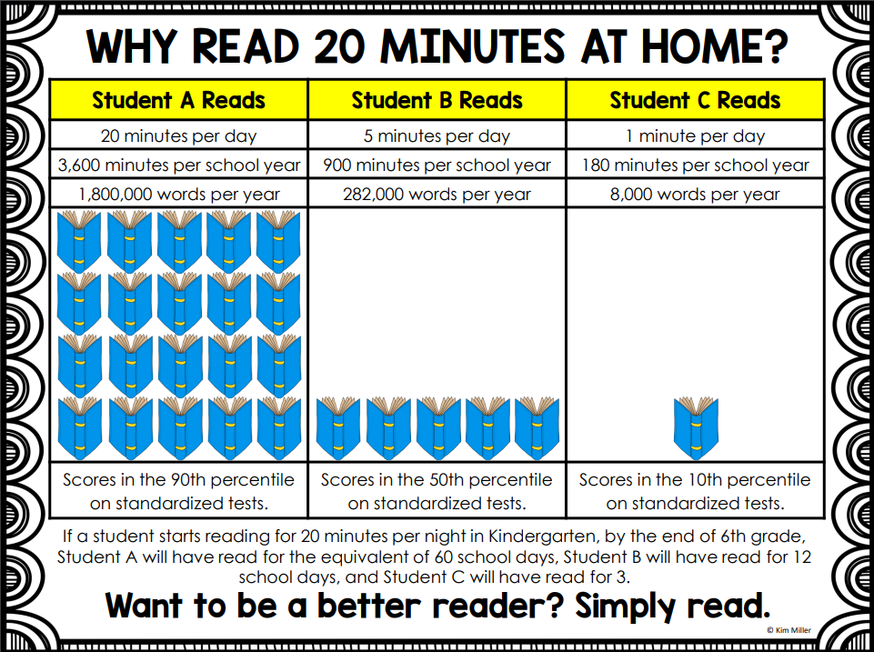
40 Book Challenge!
Students who return the Tower Mat completed appropriately on time, with 10 completed books, will be invited to have a special treat with me! All students who return the folder on time (regardless of meeting the 10 books) will receive 1 ticket for every book they have read to use towards rewards.
Parents, you might even consider an incentive for every tenth book your child adds to their tower. Here are a few fun ideas:
* Pick the family dinner.
* Mini-date with a family member.
* Pick a movie for family movie night.
* Stay up 15 minutes past bedtime.
* Choose a new book from a bookstore.
Your child will get to try some different types of books they may not have read before, and all the while have fun keeping track of their reading! Happy stacking!
Here’s how it works:
Your child’s goal is to read 10 books from the categories listed on the next direction page. Your kiddo will check off one of the boxes each time a book is read. After checking off a box, it’s time for them to add to… the Tower of Books!

Slide 8
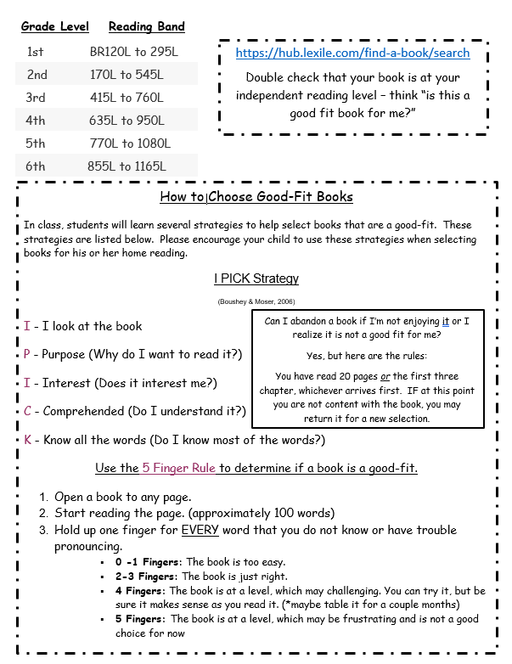

Slide 9
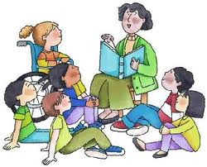
This is the year that students move from learning to read to reading to learn.
Literature
Understand the key ideas and details, determine the meaning of words, distinguish point of view, refer to parts of stories, plays, poetry when writing or speaking about text, compare and contrast literature
Informational Text (includes science, social studies)
Understand the main idea, determine domain specific words and phrases, use text features, distinguish own point of view, use information from maps and photos to demonstrate understanding, compare contrast important points in two texts on same topic
Foundational Skills
Phonics and word recognition, fluency to support comprehension

Slide 10
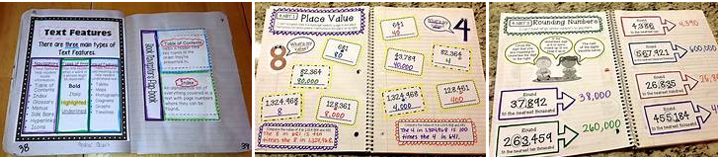
What is an Interactive Notebook?
These personal, creative notebooks become a record of each student’s growth in writing, thinking, recording, and organization skills. You may see these notebooks created in Math, ELA, Social Studies and Science.

Slide 11

The Writing Process
Prewriting
Prewriting involves using strategies to generate, plan and organize ideas for a specific purpose.
Drafting
Drafting incorporates prewriting activities to create a first draft containing necessary elements for a specific purpose.
Revising
Revising includes evaluating and refining the rough draft for clarity and effectiveness. Does the draft say what it is supposed to say?
Editing
Editing includes proofreading and correcting the draft for conventions (spelling, capital letters, punctuation, etc.)
Publishing
Publishing includes formatting and presenting a final product for the intended audience.

Slide 12
Writing Applications
Text Types and Purposes
Write opinion pieces on topics or texts, supporting a point of view with reasons.
Write narratives to develop real or imagined experiences or events using effective technique, descriptive details, and clear event sequences.
Write informative/explanatory texts to examine a topic and convey ideas and information clearly.
Goal:
Students will work towards creating a thinking map to organize ideas on a given topic, develop a 5 paragraph essay using text evidence throughout the essay, revise, edit and publish (type final draft) independently.

Slide 13
Production and Distribution of Writing (W)
With guidance and support from adults:
produce writing in which the development and organization are appropriate to task and purpose.
produce functional writing (e.g., friendly and formal letters, recipes experiments, notes/messages, labels, graph/tables, procedures, invitations, envelopes) in which the development and organization are appropriate to task and purpose.
develop and strengthen writing as needed by planning, revising, and editing.
use technology to produce and publish writing (using keyboarding skills)
as well as to interact and collaborate with others.

Slide 14

Writing application
Research to Build and Present Knowledge (W)
With guidance and support from adults produce:
writing in which the development and organization are appropriate to task and purpose.
functional writing (e.g., friendly and formal letters, recipes experiments, notes/messages, labels, graph/tables, procedures, invitations, envelopes) in which the development and organization are appropriate to task and purpose.
Range of Writing (W)
Conduct short research projects that build knowledge about a topic.
Recall information from experiences or gather information from print and digital sources; take brief notes on sources and sort evidence into provided categories.
Write routinely over extended time frames (time for research, reflection, and revision) and shorter time frames (a single sitting or a day or two) for a range of discipline-specific tasks, purposes, and audiences.

Slide 15
HMH/Language Arts:
A Balanced Reading Program
Phonemic Awareness
Phonemic awareness is the understanding that spoken words are made of individual sounds (syllables, rimes, onsets, and larger units of sound).
Phonics
Decoding is the process of translating written words into speech (word blending, word building).
Fluency
Fluency is reading with speed accuracy and expression at an appropriate rate. When reading is oral, it reflects a speech like pace.
Vocabulary
The more words a student acquires, the better chance they will have success in reading, writing and spelling.
Comprehension
Comprehension is the complex process of constructing meaning from texts. Most students need instruction in comprehension strategies.

Slide 16

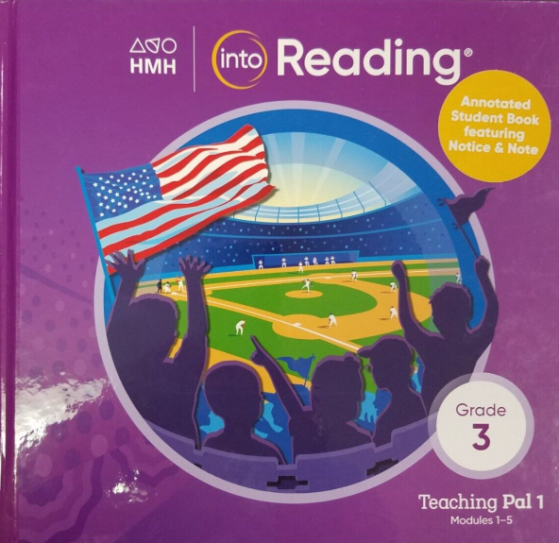
HMH Into Reading
Fluency Folder:
The Fluency Folder allows students a weekly opportunity to practice oral reading fluency at their designated level with a parent. Students will receive their Fluency Folders on Monday along with a passage to read. Directions are given inside the folder. Fluency Folders are due back on Friday
HMH/LANGUAGE ARTS:
A BALANCED READING PROGRAM
Phonemic Awareness
Phonemic awareness is the understanding that spoken words are made of individual sounds (syllables, rimes, onsets, and larger units of sound).
Phonics
Decoding is the process of translating written words into speech (word blending, word building).
Fluency
Fluency is reading with speed accuracy and expression at an appropriate rate. When reading is oral, it reflects a speech like pace.
Vocabulary
The more words a student acquires, the better chance they will have success in reading, writing and spelling.
Comprehension
Comprehension is the complex process of constructing meaning from texts. Most students need instruction in comprehension strategies.

Slide 17

GoMath
Concrete fashion using manipulatives; students then use words and pictures; finally we learn several algorithms, standard and otherwise.
Math is taught through whole group instruction, small group reinforcement, and cooperative learning groups.
Students are encouraged to make connections between math concepts and real world applications.
If it doesn’t look familiar to you, it may not be incorrect. They are going to be learning many different ways to solve ONE problem this year.

Slide 18

Numbers and Operations-Addition and Subtraction
Add and subtract whole numbers to four digits.
Create and solve word problems based on addition, subtraction, multiplication, and division.
Addition & Subtraction ONLY
Numbers and Operations-Multiplication and Division
Apply commutative, identity, and zero properties to multiplication and apply the identity property to division.
Demonstrate the concept of multiplication and division using multiple models (number line, repeated addition, array, etc)
Demonstrate fluency of multiplication and division facts through 10.
Represent all possibilities for a variety of counting problems using arrays, charts, tree diagrams, and systematic lists; draw conclusions from these representations
Create and solve word problems based on addition, subtraction, multiplication, and division.
Solve a variety of problems based on the multiplication principle of counting.
Number and Operations-Fractions
Compare and order benchmark fractions.
Express benchmark fractions as fair sharing, parts of a whole, or parts of a set
Fractions on a number line
Fraction equivalence

Slide 19

Number Sense
Express whole numbers through six digits using and connecting multiple representations.
Compare and order whole numbers through six digits by applying the concept of place value.
Count and represent money using coins and bills to $100.00.
Sort whole numbers into sets and justify the sort.
Make estimates appropriate to a given situation or computation with whole numbers
Patterns, Functions, and Relationships
Recognize and describe a relationship between two quantities, given by a chart, table or graph, in which the quantities change proportionally, using words,
pictures, or expressions.
Explain the rule for a given numerical sequence and verify that the rule works.
Use a symbol to represent an unknown quantity in a given context.
Use a symbol to represent an unknown quantity in a given context.

Slide 20
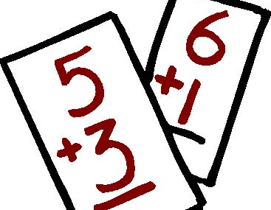
Math facts are an important part of number sense. Many math concepts spiral and it is important for your child to have a solid understanding of their math facts. We will be reviewing/learning addition and subtraction facts. If your child does not know these facts automatically please practice them on a regular basis…the more they practice the better they will get. During first quarter we will begin learning multiplication facts. It will be important to practice and learn those facts automatically as well.
www.xtramath.org

Slide 21


Social Science
Science
The inquiry process
question, plan, conduct investigations and use appropriate tools to gather data, communicate the results of their investigations in a variety of ways.
As a class, we will participate in the science fair in January.
Investigate through inquiry
Social Sciences
Social studies instruction will involve
•research,
•projects,
•activities as well frequently integrating reading and writing.
This year your child will be learning about Arizona.
Science and Social Science are now crosscut content areas. Third grade has a focus on Arizona for both Science and Social Science.

Slide 22
Assessments
DIBELS = Dynamic Indicator of Basic Early Literacy Skills – Determines basic reading ability and diagnoses reading strengths and or needs. Given 3 times a year.
SchoolCity for Math and Reading – 1 test per quarter: pre-test, test 1, test 2, posttest.
AASA State Testing ~ April 2023
Classroom assessments ~ teacher created tests/quizzes, Journeys assessments, individual and group work, projects, presentations participation, observation, along with other activities.

Slide 23
Homework and Grading
Letter Grade | %
A | 90+
B | 80 - 89
C | 70 - 79
D | 60 - 69
F | 50 - 59
Homework will be sent home as needed and typically will be due the following day, though some work will be extended throughout the week. Homework consists of spelling activities, reading( at least 20 minutes nightly) and practicing math, and may even be work the student was unable to complete during our class time.
It is my goal to make homework “user friendly” to both students and parents. Ultimately, your child is responsible for his/her homework; however, please take an active role in encouraging and providing direction when needed. Parents are the best teachers!

Slide 24
Thank you so much for coming. I can’t wait to work with your child this school year!
I look forward to seeing your child’s academic, social, and emotional growth this year.
If you ever have any question, concerns, or comments, please feel free to call, set up a meeting, or email me.
480-883-4759
Ross.hannah@cusd80.com
Thank you!

